Slide 1

Data Analytics in Insurance
Corey Arnouts
Enterprise Data Analyst, Farm Bureau Insurance of Michigan
February 26, 2020

Slide 2

Who am I?
Enterprise Data Analyst at Farm Bureau
Applied Mathematics Major Undergrad
Master’s in Data Science Student

Slide 3
Today’s Agenda
Farm Bureau Insurance background
Data Analytics use cases in insurance
Tooling of Data Analytics

Slide 4

Farm Bureau Insurance

Slide 5

Farm Bureau Insurance
Michigan Farm Bureau & Farm Bureau Insurance
Variety of insurance products
Farmowners, Homeowners
Automobile
Commercial Property, Liability
Life
Annuity & Retirement
Notes:
MFB created in 1919 – 100 years
Organization that supports, represents, advocates MI agricultural industry
Large corporations, small family farms, hobby farms
MFB - nearly 1K employees statewide
FBI created in 1949 – 70 years
Products
Community
Distracted driving
Relay for life
ACES
School makeovers
MHSAA
MSU, Pistons athletics

Slide 6
Farm Bureau Insurance
Data Analytics Department
Upgrading internal systems
Wanting to put more data to more use
Work smarter
Gain advantages where possible
Ad hoc requests for data and analysis
Descriptive, diagnostic
Dashboards beyond reporting
Deeper-dive projects
Predictive modeling
Enhance decision-making, business operations
More data analysts in business areas
Notes:
Department created in 2014
Leveraging data from updated systems
Early focus on descriptive, some diagnostic analytics
More predictive modeling for decision/operations support
Spend more time using expertise/critical thinking than busywork
Greater demand for data and analysis leading to business positions

Slide 7





Tooling Used
Notes:
MFB created in 1919 – 100 years
Organization that supports, represents, advocates MI agricultural industry
Large corporations, small family farms, hobby farms
MFB - nearly 1K employees statewide
FBI created in 1949 – 70 years
Products
Community
Distracted driving
Relay for life
ACES
School makeovers
MHSAA
MSU, Pistons athletics

Slide 8

Tooling Used
Bread and Butter of Data Tasks at Farm Bureau
ETL Developers, DBAs, Data Analysts, others all use this tool
Go to tool for querying from a database
Uses Transact SQL or T-SQL
We use on premises servers so all of our database infrastructure is ran through SQL Server
Notes:
MFB created in 1919 – 100 years
Organization that supports, represents, advocates MI agricultural industry
Large corporations, small family farms, hobby farms
MFB - nearly 1K employees statewide
FBI created in 1949 – 70 years
Products
Community
Distracted driving
Relay for life
ACES
School makeovers
MHSAA
MSU, Pistons athletics

Slide 9
Tooling Used
Reporting
Visualization
Geospatial Analysis
Time Series Analysis
Easier Learning Curve
Enterprise Software you have to pay for
Great to be easily consumed by Business Users and Decision Makers
Notes:
MFB created in 1919 – 100 years
Organization that supports, represents, advocates MI agricultural industry
Large corporations, small family farms, hobby farms
MFB - nearly 1K employees statewide
FBI created in 1949 – 70 years
Products
Community
Distracted driving
Relay for life
ACES
School makeovers
MHSAA
MSU, Pistons athletics

Slide 10
Tooling Used
Used for Data Analysis, Visualization, Different Types of Statistics
Very rich in different statistical packages
Not a terrible learning curve to getting started
Great Community that loves to help #rstats on twitter
https://corey-arnouts.shinyapps.io/Data_608_Project_3/
Shinyapp Not as out the box polished as something like tableau but it is more configurable and versatile
Versatile
Best tool out there for various types of statistical analysis
Notes:
MFB created in 1919 – 100 years
Organization that supports, represents, advocates MI agricultural industry
Large corporations, small family farms, hobby farms
MFB - nearly 1K employees statewide
FBI created in 1949 – 70 years
Products
Community
Distracted driving
Relay for life
ACES
School makeovers
MHSAA
MSU, Pistons athletics

Slide 11
Tooling Used
Data Science Flow Tool
Great Graphical Interface for Doing Data Science
Can utilize a lot of other tools in it
Glue for data science workflows
Easy to make changes
Great for reproducibility of results
Automation of tasks
Notes:
MFB created in 1919 – 100 years
Organization that supports, represents, advocates MI agricultural industry
Large corporations, small family farms, hobby farms
MFB - nearly 1K employees statewide
FBI created in 1949 – 70 years
Products
Community
Distracted driving
Relay for life
ACES
School makeovers
MHSAA
MSU, Pistons athletics

Slide 12
Use Case: Auto Re-underwriting model
Right now when we get new clients their policies get auto applied and rated based off the criteria that they fill out with the agent
Number of drivers
Number of vehicles
Types of coverages they want
How much they drive
What is their driving record
Do they have health insurance that covers auto accidents
With most of these things there is the opportunity for clients to misrepresent themselves in some way
The re-underwriting model helps detects this based off historical data we have from clients who have done that in the past
Outputs of the model tell the underwriters what policies to take a closer look at
Notes:
MFB created in 1919 – 100 years
Organization that supports, represents, advocates MI agricultural industry
Large corporations, small family farms, hobby farms
MFB - nearly 1K employees statewide
FBI created in 1949 – 70 years
Products
Community
Distracted driving
Relay for life
ACES
School makeovers
MHSAA
MSU, Pistons athletics

Slide 13
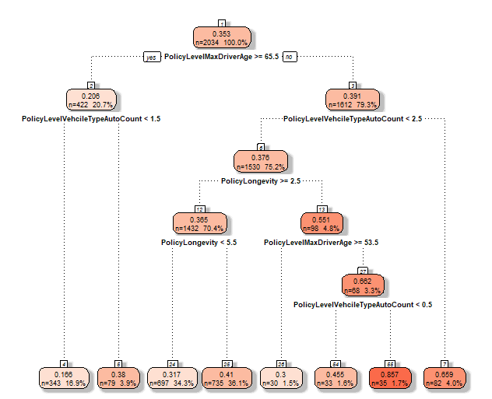

Slide 14
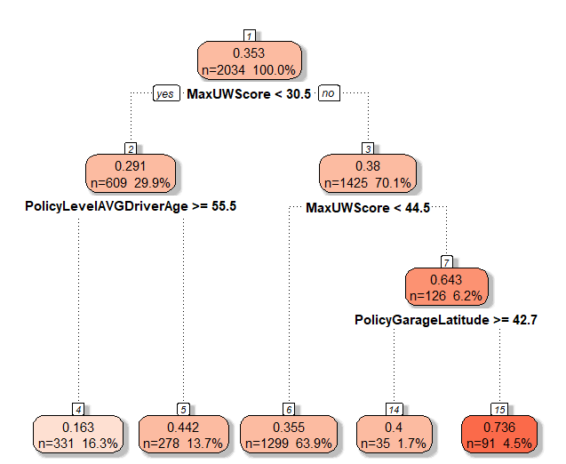

Slide 15
Tooling Used
One of the most versatile programming languages
Software Development, Web Development, Data Science
Viewed as superior to R when productionizing Machine Learning Models
Growing Data Science Packages
Sci-kit learn
Pandas
Numpy
Notes:
MFB created in 1919 – 100 years
Organization that supports, represents, advocates MI agricultural industry
Large corporations, small family farms, hobby farms
MFB - nearly 1K employees statewide
FBI created in 1949 – 70 years
Products
Community
Distracted driving
Relay for life
ACES
School makeovers
MHSAA
MSU, Pistons athletics

Slide 16
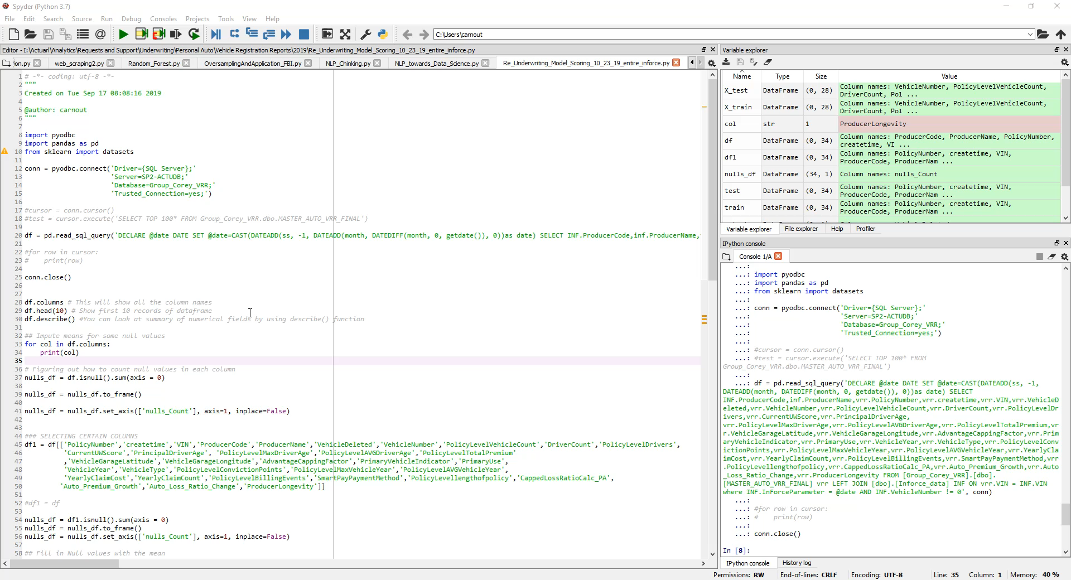

Slide 17

Use Cases in Insurance

Slide 18
Insurance Use Cases
Straight-through processing
What needs reviewed, what doesn’t?
Reunderwriting efforts
What needs investigated, what doesn’t?
Property inspections
Efficiently find/correct problem conditions
Automation of certain claims
Image recognition, processing
Payment estimation
Fraud detection
Fraudulent claims
Policy misrepresentation

Slide 19
Insurance Use Cases
Claim complexity triaging
Routing claims to the right adjustor
Litigation potential
Earlier involvement to reduce ultimate severity
Subrogation potential
Reduce overlooked loss recoupments
Quote conversion
Where are we most/least competitive?
Insight into types of business to prospect
Policy retention
For business likely to leave, reach out or not
Component of customer lifetime value

Slide 20
Insurance Use Cases
Cross-selling or up-selling
Growing book of business from within
Bundling benefits on both sides
Web analytics
Customer behavior, engagement
Streamlined website functionality
Telematics
Customized premium determination
Profiling, notification services
General IoT enhancements
Notification of water, theft, fire events
Damage verification

Slide 21

Past Project Partnerships

Slide 22
Farm Bureau & MSU Projects
Policy retention
Multiple projects
Attempting to predict policy attrition
Used to determine cases for advance contact, as well as initial prospecting
Unique challenges: imbalanced target variable, policies that lapse/reinstate
Cross-selling existing business
Attempting to understand PC business with high propensity to purchase Life products
Pursue high-scoring business without Life products
Unique challenges: all owned Life insurance not with Farm Bureau, incomplete customer view

Slide 23
Farm Bureau & MSU Projects
Property inspections
Attempting to identify which properties should be physically inspected
Unique challenges: target variable issues (“interference”, feedback, volume), multiple approaches
Agent performance
Attempting to identify agents who over- or under-perform relative to profitability expectations
Simple profitability measures not enough
Learn from over-performing agents, coach those who are under-performing, improve recruiting
Unique challenges: nuances by coverage, geographic influence

Slide 24

Student Questions?
Corey Arnouts Enterprise Data Analyst
(517) 927-1443

